Slide 1


Name/Claim/Aim
A new crisis resource management paradigm
Center for Medical Simulation

Slide 2
NAME
CLAIM
AIM
Name Dx or changes in vital signs out loud
If applicable, include: you’re not sure what the underlying diagnosis is
Recap at intervals
Claim/Delegate Event manager or Team Leader (must be inclusive and inviting)
Claim/Designate roles
Aim Team
  State or modify the plan, specify interventions
  If applicable, include: gathering data for underlying diagnosis if unknown
Seek further input
Consult Emergency Manual

Slide 3
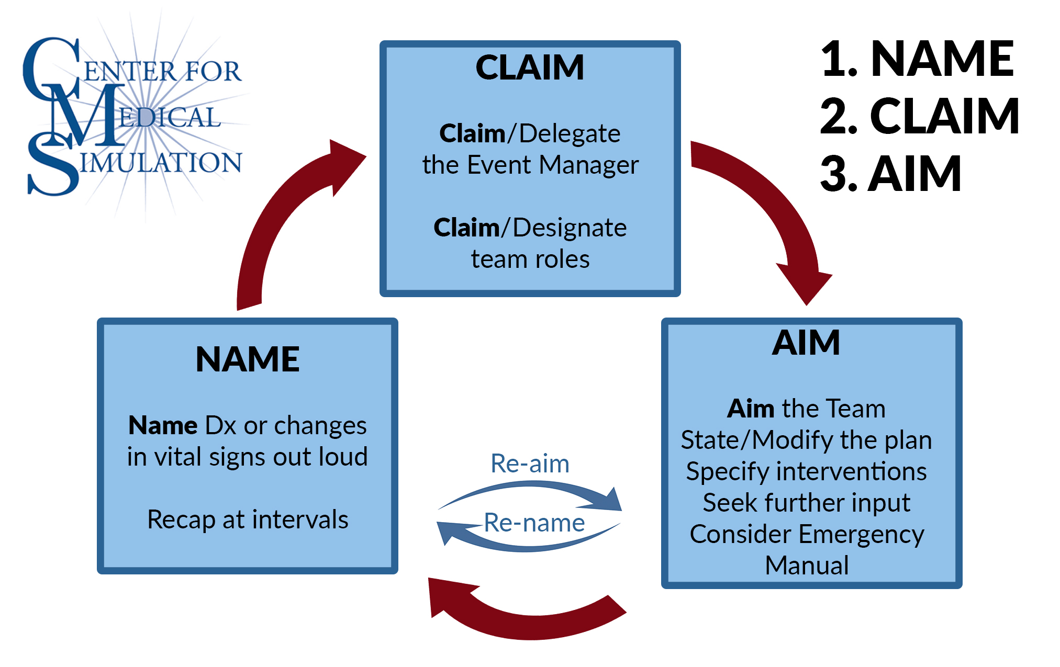

Slide 4

Leaders can enable or inhibit speaking-up
Explicit display of openness, availability and accessibility by leaders
Others’ perceptions matter most
“We all need to contribute ideas and thoughts”
Minehart RD et al 2020, Barzallo Salazar MJ et al 2014, Appelbaum NP et al 2016.
Notes:
Leadership inclusiveness was predictive of intention to report adverse events, as mediated by psychological safety. “Your opinion matters” led to 82% vs 30% of medical students speaking up during a simulation when the attending surgeon was about to make an error.

Slide 5
THANK YOU!
Email: rminehart@mgh.harvard.edu
Be kind to yourselves and others during this time

