Slide 2
Obstetric Anesthesia and COVID19: Simulation Exercises
Author: Rebecca D. Minehart, MD, MSHPEd
Contributors: Gill Abir, MD; Katie Arendt, MD; Erik Clinton, MD; Roxane Gardner, MD, MSHPEd, DSc; Daniel Katz, MD; Allison Lee, MD; Vanessa Torbenson, MD
Special thanks to Albert Chan, MD; Vivian Lau, MD; Henry Wong, MD (Prince of Wales Hospital, Hong Kong)
Updated March 18, 2020

Slide 3
Key Learning Objectives
At the end of this exercise, learners will be able to:
Demonstrate steps to care for a pregnant woman on labor and delivery with suspected COVID19
Apply strategies to escalate care for a pregnant woman with suspected COVID19 while limiting exposure to yourself and other healthcare workers
Identify the location and supply source of PPE equipment on your unit

Slide 4
Overview of schedule
Introductions: 5 minutes
Prebrief (“ground rules”): 5 minutes
Refresher on what we know about COVID19: 5 minutes
Drill: 20 minutes [modify according to which stages—may involve multiple drills over an hour] with pauses and discussions
Debriefing: 20 minutes
Evaluations: 5 minutes
Total time: 1 hour

Slide 5
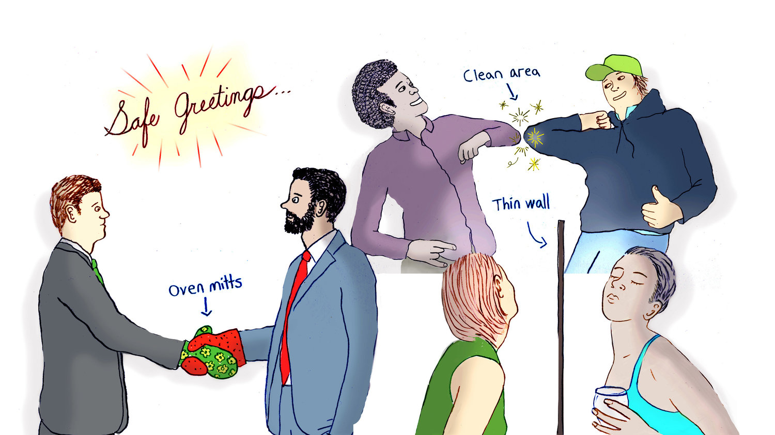
Introductions: Simulation Drills
Name
Role
Prior sim experience
Fun fact
https://www.npr.org/sections/goatsandsoda/2018/02/03/581805417/the-liberian-elbow-bump-is-your-good-friend-during-flu-season

Slide 6
Pre-brief: Simulation Drills
The purpose of this is to come together to practice rare situations related to COVID19
We start with the basic assumption that all of us here are intelligent, capable, care about doing their best, and want to improve
Missteps (and also things done well) can help us learn and we will highlight these
We may pause and interrupt the drill to highlight things for our learning and then have you redo certain parts
Focus on the problems being real, even if the equipment/mannequin is not
Act as you normally would act

Slide 7
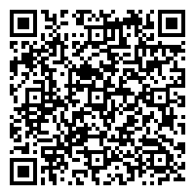
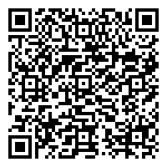
Refresher: What we know about COVID19
Has a long incubation time
Many with mild symptoms
Spread by droplets
Currently, most testing is limited so unknown community spread
Guiding principle is to minimize healthcare personnel exposed to patients who may have COVID19
For the most recent COVID19 updates, access these selected resources:
SOAP: CDC guidelines: WHO: DEA Drug Shortages:

Slide 8
Refresher: What PPE do I need?
[Insert institutional guidelines here]
Best is to limit COVID19 spread by having symptomatic patients wear masks and alerting personnel in L&D units ahead of time that patients are coming
Aerosolizing procedures (e.g., intubation) are thought to be riskier for spread
For patients with COVID19 or suspected COVID19:
For neuraxial procedures: surgical mask plus PPE (or per institution)
For intubation: N95 mask or PAPR for ALL PERSONNEL in room (or per institution)

Slide 9
What questions do you have before the drill?
https://insight.ieeeusa.org/articles/never-have-any-questions-as-your-last-slide/

Slide 10
Drill: Meet your patient
Cori Vidman is a 30 yo G2P1 female at 37w2d in active labor
Her PMH includes asthma, h/o rapid first labor, and a 1-wk history of cold-like symptoms, including cough. No known COVID19 exposures.
[Modify parts below per institutional plan to drill]
Part 1: Triage evaluation
Part 2: Moving from triage to labor room (with neuraxial placement)
Part 3: Fetal bradycardia and transfer to the OR
Part 4: STAT Cesarean delivery and conversion to general anesthesia with intubation
Part 5: Neonatal resuscitation and transport
Part 6: Extubation, recovery, and disposition of patient

Slide 11
Debrief: Key Points
Any reactions to the scenario before we start?
We will be covering the checklist of steps
Identify what we did well, what we need to practice more, and what unanswered questions we still have

Slide 12
Next steps: Follow-up
Please fill out your evaluations
We will be in touch to follow-up with further questions you raised today
Thank you for your participation!
https://www.swedishnomad.com/thank-you-in-different-languages/

